Slide 1
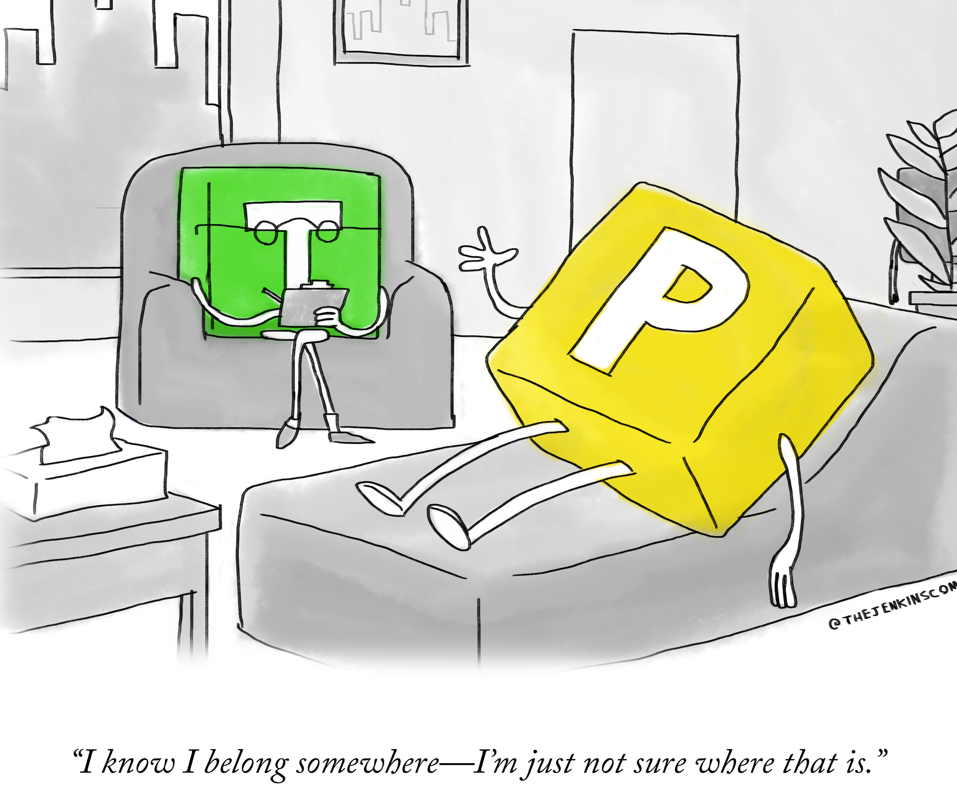
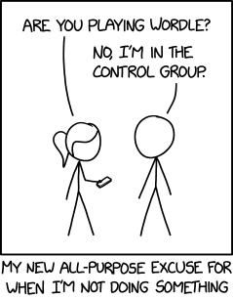
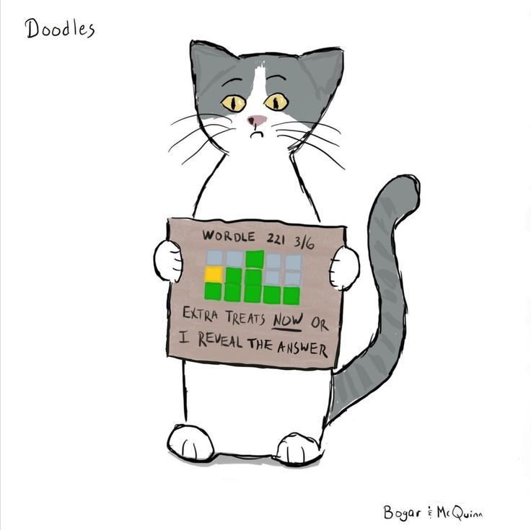
Wordle Part 2: output and gameplay.
Week 10 | Lecture 3 (10.3)
While waiting, open the Wordle Part 2 Starter Notebook
Upcoming:
Lab 7 released Thursday 6:00 pm.
Reflection 10 released Friday 6:00 pm.

